Slide 1

Uber Booking & Revenue Analysis
SQL-driven insights into booking completion, revenue drivers, and operational leakage

Slide 2

The Completion Crisis: 62% Success Rate
150K
62%
Total Bookings
Completion Rate
Full demand captured in the dataset
Only 93,000 rides reached the destination
₹47.26M
Completed Revenue
With ₹30M+ potential revenue at risk
38% of all demand is lost to cancellations, no-driver-found events, and incomplete rides — a systemic operational gap demanding immediate executive attention.

Slide 3
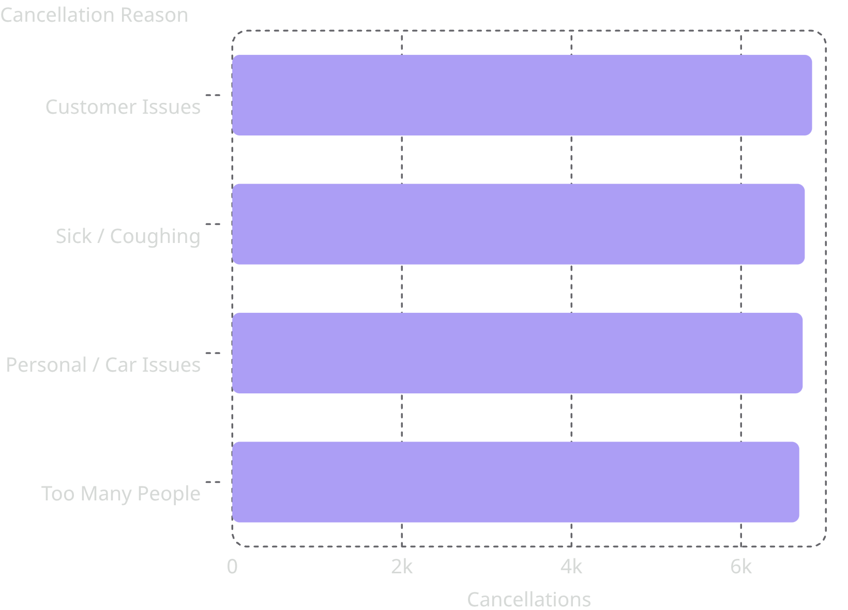

Driver Cancellations: The Biggest Loss (18%)
27,000 cancellations — 18% of all bookings
Driver cancellations are the single largest source of demand leakage. The four root causes are nearly equal in volume, suggesting a systemic rather than isolated problem.
Recovering just 10% of driver cancellations = ₹1.37M additional revenue

Slide 4
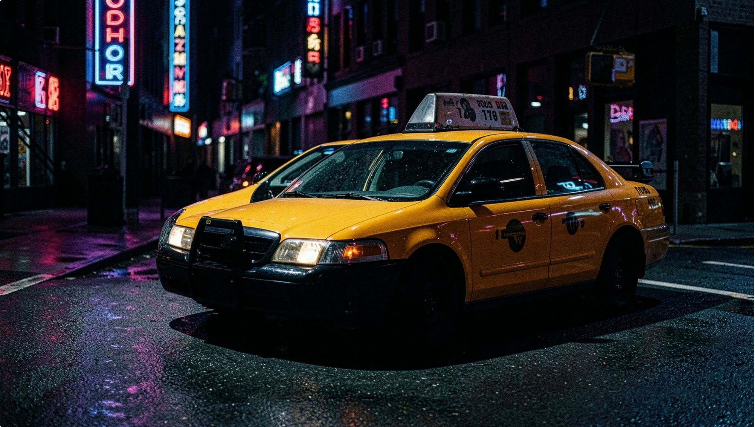

No Driver Found: 7% Lost Demand
10,500 bookings — 7% of total volume — resulted in no driver being assigned. This demand is concentrated in specific locations and peak hours, pointing to a supply distribution problem rather than an absolute shortage.
Hyper-local supply gaps in high-demand zones
Peak-hour exposure compounds the problem
Demand exists but goes completely unserved
Recovering 20% of no-driver-found events = ₹1.07M additional revenue

Slide 5
Other Leakage: Customer Cancellations & Incomplete Rides
Customer Cancellations
Incomplete Bookings
Combined Impact
10,500 bookings — 7% of total demand. Riders initiated but abandoned before pickup, indicating friction in wait time or driver ETA.
9,000 bookings — 6% of total demand. Rides that entered the system but never reached completion due to technical or operational failure.
19,500 bookings — 13% of total demand lost from two secondary but significant leakage sources alongside driver issues.

Slide 6

Peak-Hour Bottleneck: 6 PM Demand Surge
The 6 PM window is Uber's highest-demand moment — and its most vulnerable. Cancellation and no-driver rates at peak mirror the platform-wide averages, confirming that supply fails to scale with demand at the most critical hour.
Opportunity: Targeted driver incentives during the 5–7 PM window could meaningfully reduce leakage at peak.
7,617
Completed rides at 6 PM peak
18.2%
Driver cancellation rate at peak hour
7.2%
No-driver-found rate at peak hour

Slide 7
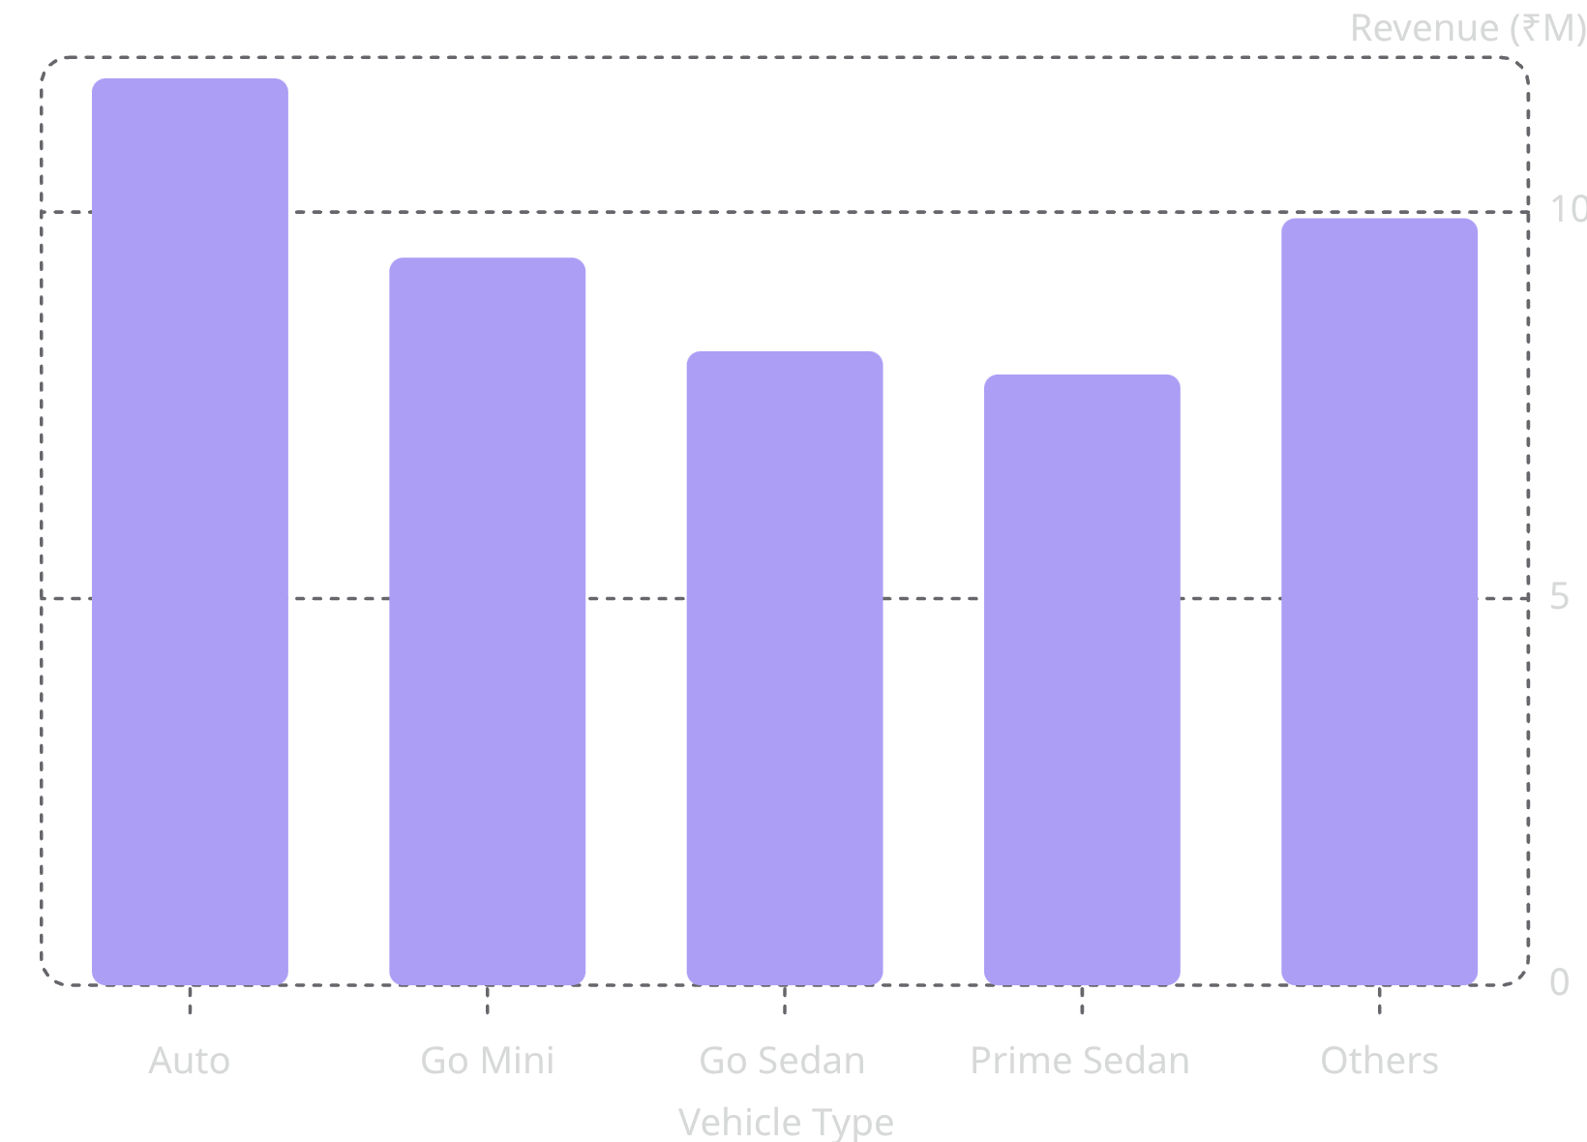
Revenue by Vehicle Type: Auto Leads, Go Sedan Excels
Auto dominates volume; Go Sedan wins on efficiency
Auto: ₹11.73M — 24.82% of total revenue across 23,155 rides
Go Mini: ₹9.41M — strong volume-driven contribution
Go Sedan: ₹19.71/km efficiency and ₹512 average booking value — highest per-ride yield
Go Sedan's superior unit economics make it a candidate for targeted supply growth despite lower overall volume.

Slide 8
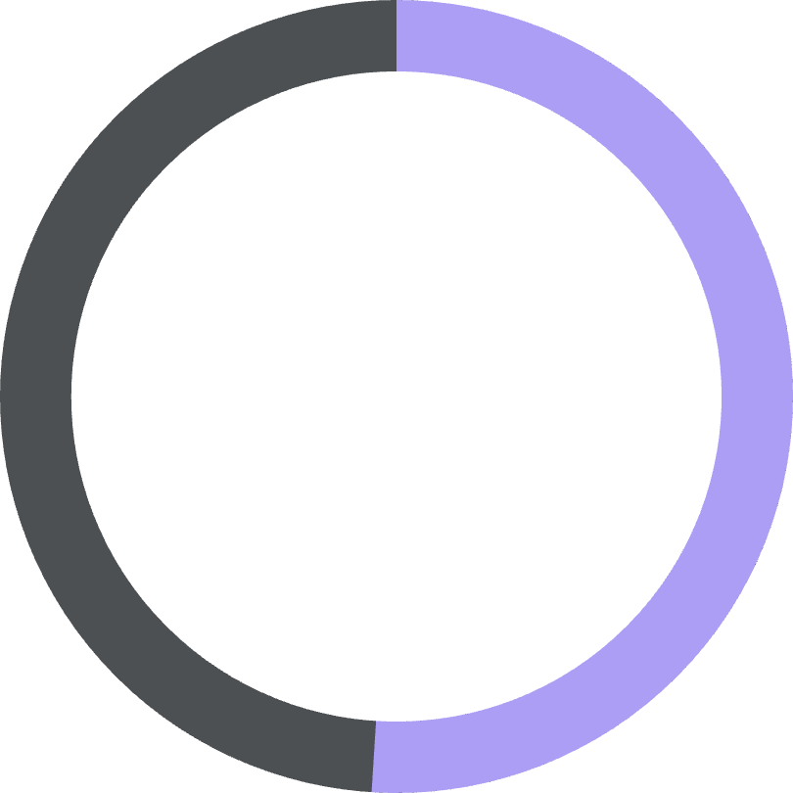

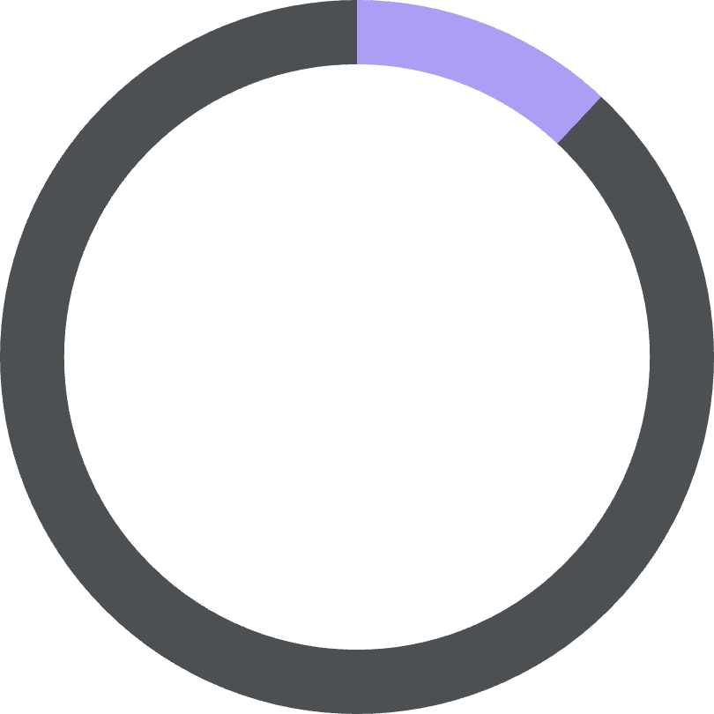

Customer Segments: First-Time Riders Drive Revenue
51%
37%
12%
First-Time Riders
Regular Riders (3–5 rides)
All Other Segments
51.3% of completed revenue — new customers are the primary revenue engine
36.6% of completed revenue from repeat customers
Remaining share from power users and occasional riders
Heavy reliance on new customer acquisition signals low repeat conversion — a long-term retention risk that undermines sustainable growth.

Slide 9
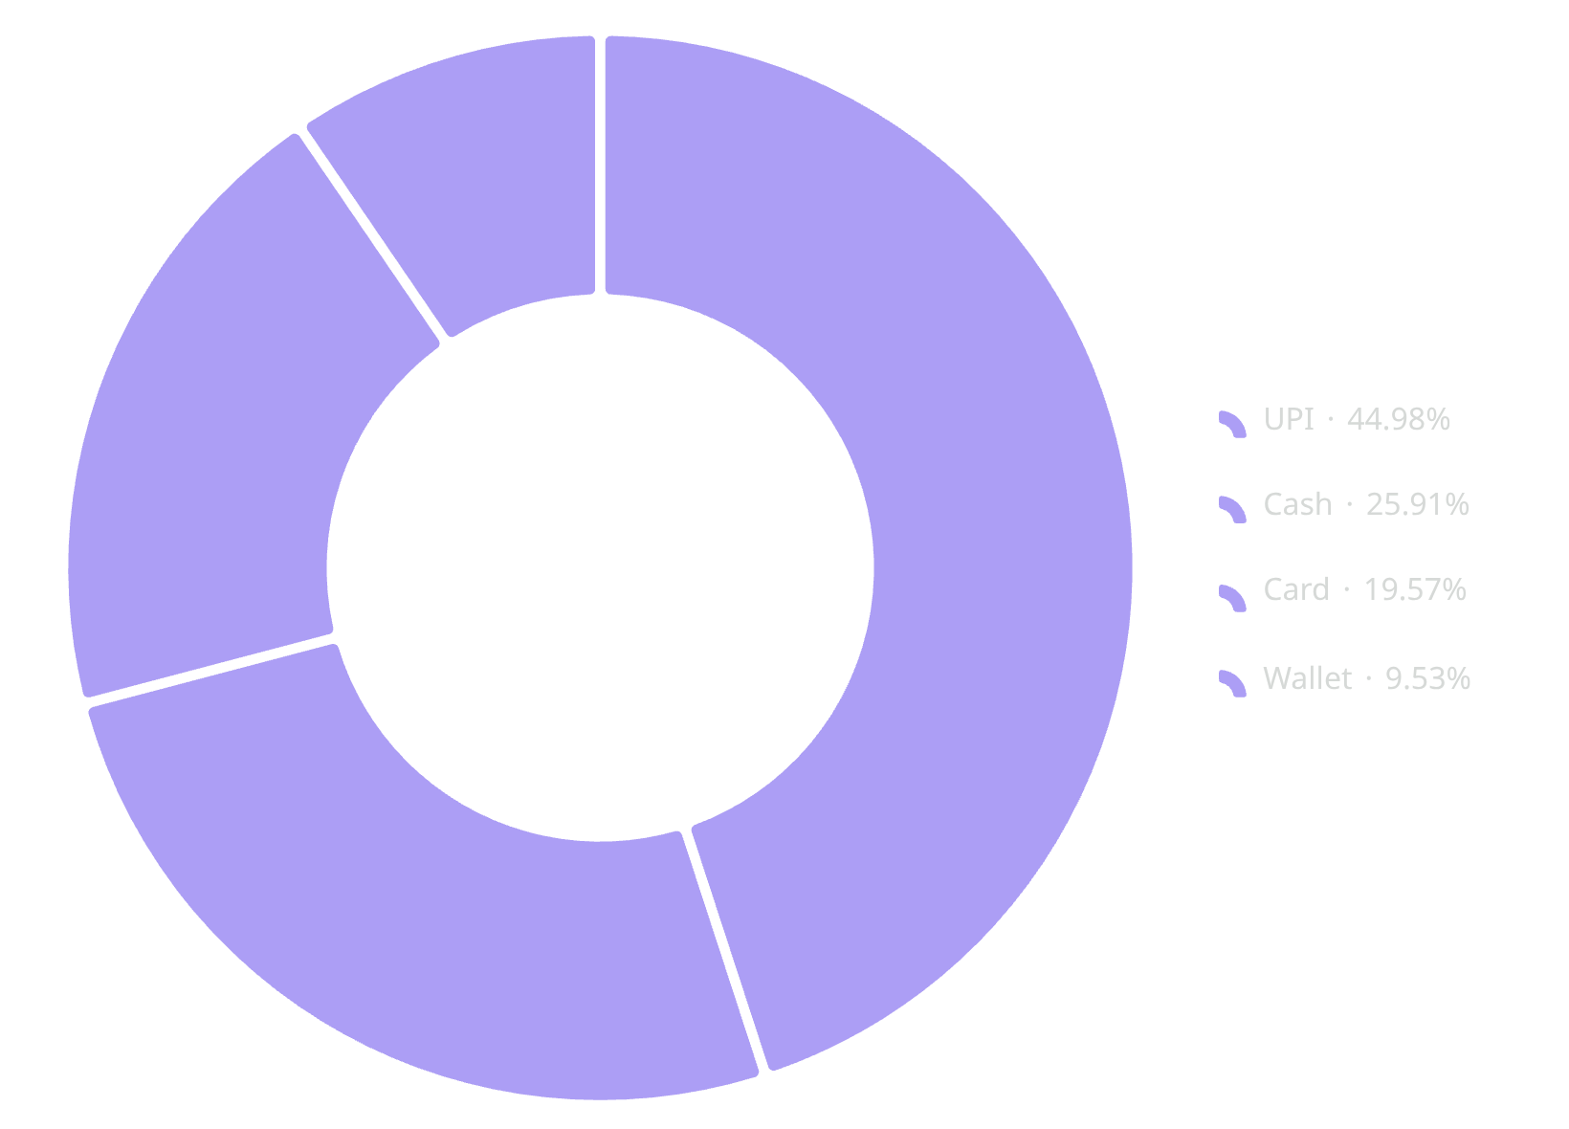
Payment Method: UPI Dominates Volume, Cash Leads Value
Payment behavior reveals a strategic split: UPI commands the largest share of completed ride volume, while cash transactions yield higher average booking values.
UPI: 41,834 bookings — 45% of all completed rides
Cash: ₹11.76M revenue — 24.87% of total, ranking second by value
UPI is the volume leader; cash is the value leader. Optimizing digital payment incentives could shift cash riders toward UPI while preserving revenue yield.

Slide 10
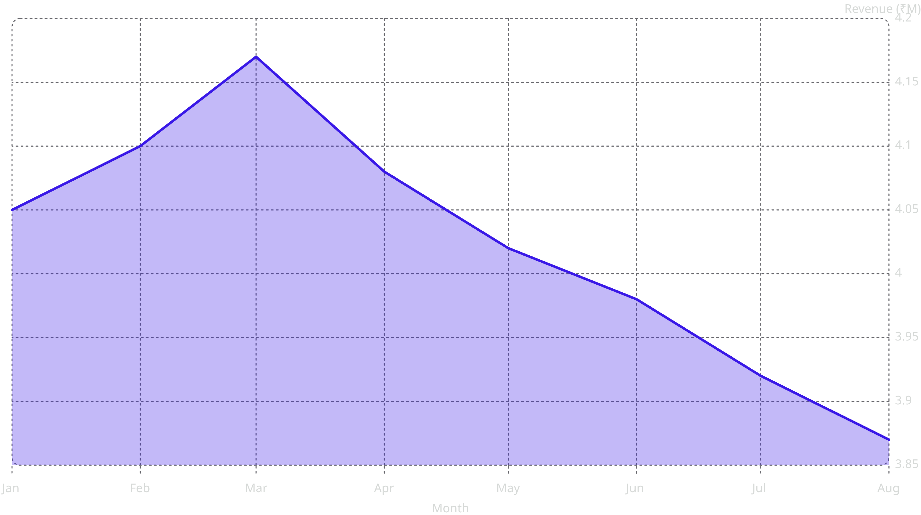
Monthly Performance: March Peak, August Trough
A 7% revenue gap between the March peak (₹4.17M) and August trough (₹3.87M) points to seasonal demand-supply misalignment. Proactive driver incentive programs ahead of the August dip could narrow this variance significantly.

Slide 11



Priority Actions & Business Impact
Fix Driver Cancellations
1
Deploy targeted interventions for the four root causes. 10% recovery = ₹1.37M incremental revenue.
Close Supply Gaps at Peak
2
Incentivize driver availability in high-demand zones during the 5–7 PM window. 20% no-driver recovery = ₹1.07M.
Build Repeat Rider Loyalty
3
Reduce dependence on first-time riders (currently 51.3% of revenue) by investing in retention programs to convert new riders into regulars. Combined leakage opportunity: ₹3.4M+.

